Slide 1
Security Hardening – Case Study – Solaris
Solaris 10 X86
DISA, Release 18
28 April 2017

Slide 2
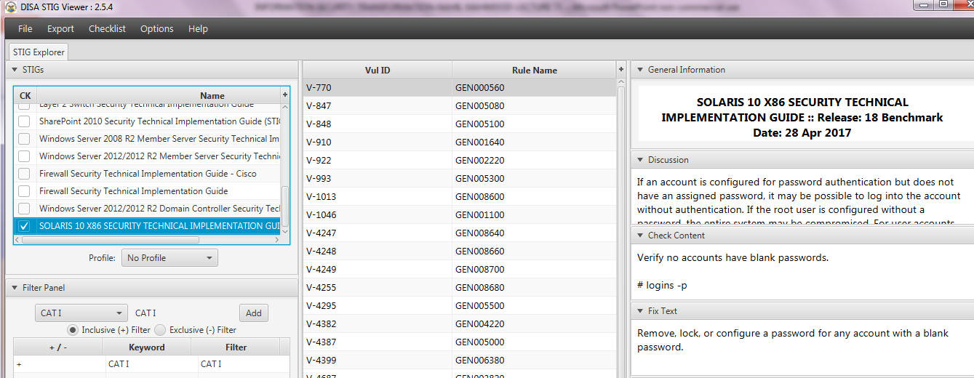
Security Hardening – Case Study – Solaris
STIGVIEWER WINDOW

Slide 3
Security Hardening – Case Study – Solaris
General Information:
Rule Title: All shell files must have mode 0755 or less permissive
STIG ID: GEN002220
Severity: CAT I

Slide 4
Security Hardening – Case Study – Solaris
Discussion:
Shells with world/group-write permissions give the ability to maliciously modify the shell to obtain unauthorized access.

Slide 5
Security Hardening – Case Study – Solaris
Check Content:
If /etc/shells exists, check the group ownership of each shell referenced. # cat /etc/shells | xargs -n1 ls -lL
Otherwise, check any shells found on the system. # find / -name "*sh" | xargs -n1 ls -lL

Slide 6
Security Hardening – Case Study – Solaris
…Check Content:
If a shell has a mode more permissive than 0755, this is a finding

Slide 7
Security Hardening – Case Study – Solaris
Fix Text:
Change the mode of the shell # chmod 0755 <shell>

Slide 8
Security Hardening – Case Study – Solaris
CCI (Control Correlation Identifier):
CCI-000225 The organization employs the concept of least privilege, allowing only authorized accesses for users (and processes acting on behalf of users) which are necessary...

Slide 9
Security Hardening – Case Study – Solaris
…CCI (Control Correlation Identifier):
…to accomplish assigned tasks in accordance with organizational missions and business functions

Slide 10
Security Hardening – Case Study – Solaris
…CCI (Control Correlation Identifier):
…NIST SP 800-53 :: AC-6 NIST SP 800-53A :: AC-6.1 NIST SP 800-53 Revision 4 :: AC-6

